Slide 1
THE TREATMENT OF ADDICTION Steven G Weaver MD FASAM
January 11, 2024

Slide 2
DISCLOSURES
I have no disclosures

Slide 3
Qualifications
FHU: 1980-1985
UTCHS: 1985-1989
INTERNSHIP: INTERNAL MEDICINE : 1989-1990
USN/USMC: 1990-1994
RESIDENCY: INTERNAL MEDICINE 1994-1996
CPE: 2007
HOSPITALIST
LPC/MHSP
BOARD CERTIFIED IN ADDICTION MEDICINE AND INTERNAL MEDICINE

Slide 4
OBJECTIVES
List the methods to treat addiction
Describe the history of Medication Assisted Recovery (MAR)
Understand the pathophysiology of MAR in OUD

Slide 5
TREATMENT FOR ADDICTION
Kill Addicts
Lock all addicts up
Prohibition
Psychosocial Treatment
Pharmacotherapy

Slide 6
PHARMACOTHERAPY
Also known MAT (medication assisted treatment)
Alcohol Tobacco
Disulfiram Nicotine Replacement Therapy
Naltrexone gum, patches, spray, inhaler, lozenges
Acamprosate Buproprion and Varenicline

Slide 7
HISTORY OF MAT
Cocaine to treat morphine addiction
Sigmund Freud 1884 On Coca

Slide 8
HISTORY OF MAT
William Halstead “Father of American Surgery”
His personal physician was William Osler, cofounder of John Hopkins
Osler treated Halstead’s cocaine addiction with morphine
Halstead was addicted to morphine the rest of his life

Slide 9
HARRISON NARCOTIC ACT OF 1914
Initially the act stated ONLY physicians could write opioids
Then the act was changed to say physicians could not write opioids to known opioid addicts

Slide 10
HARRISON NARCOTIC ACT
1919 Webb Decision Supreme Court
Criminalized possession and use of opioids
Criminalized doctors who prescribed opioids to addicts

Slide 11
HARRISON NARCOTIC ACT
25,000 physicians were prosecuted under the Harrison Act
3000 physicians WENT TO JAIL!!!! (Memphis)
Result: Physicians stopped treating addiction and avoided addicts

Slide 12
REASONS FOR MAT WITH OUD
Harm Reduction
Bridge to recovery

Slide 13
NALTREXONE
Weakness
Cravings continue
Large number of people relapse during the washout period
Very useful in certain populations
Healthcare professionals
Business Executives
Drug courts

Slide 14
NALTREXONE VS NALOXONE
Both are Mu receptor blockers
Naloxone Naltrexone
Rapid onset Delayed onset
Short acting Long acting
No po bioavailability Bioavailable po
Acute overdose Used to treat OUD
IV, SQ, IM, Intranasal IM(vivitrol) or PO(Revia/Depade)

Slide 15
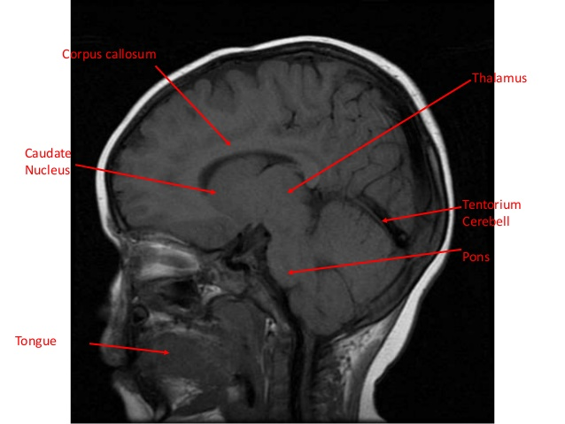

Slide 16
MAT FOR OPIOID USE DISORDER
Full Agonist
Methadone….OTP
Full Antagonist
Naltrexone
Partial Agonist
Buprenorphine

Slide 17
HOW A FULL AGONIST WORKS

Slide 18
PARTIAL AGONIST

Slide 19
BUPRENORPHINE
DATA 2000
Allowed physicians for the first time since 1915 to treat OUD in the office

Slide 20
FORMULATIONS OF BUPRENORPHINE
Buprenorphine(subutex)

Slide 21
FORMULATIONS OF BUPRENORPHINE
NARCAN ADDED

Slide 22
FORMULATIONS OF BUPRENORPHINE
Buprenorphine-naloxone
Suboxone
Bunavail
Zubsolv

Slide 23
FORMULATIONS OF BUPRENORPHINE
Kleenex

Slide 24
CASE STUDY
Sally M is a 34-year-old woman from West Tennessee. Her father was an alcoholic and her mother was addicted to heroin. Her mother died of an overdose when Sally was 12. Her father moved them in with her paternal grandparents after her mom’s death. Shortly thereafter her adult uncle began abusing her sexually which continued until she was 16 when she left home and moved in with her boyfriend to escape the abuse. She had her first child when she was 17. She eventually married her boyfriend even though he routinely beat her. At the age of 20 he beat her so badly she spent 2 months at the MED and he went to prison. She began using drugs at age 12. Thru the years she has used marijuana, opioids of all kinds including IV heroin, methamphetamine, cocaine and alcohol. Her DOC however is definitely opioids.

Slide 25
CASE STUDY
She managed to get an AA degree in her early 20’s and has worked in a factory for the last 8 years. Originally, she worked on the line but when I first met her, she worked in the accounting department. She has 3 kids who are 17, 12 and 6.
In 2012 she weaned herself off IV heroin by using oxycodone she bought off the street. She has been using oral pharmaceutical opioids since.
She tested positive on a random drug screen at her workplace in 2014. Instead of firing her the HR manager, who is a friend of mine, referred her to me for options. I started her on buprenorphine. Initially she was not interested in counseling, but she relapsed at 6 months, and I convinced her to try counseling. She did very well in counseling especially with the use of EMDR. She stayed on buprenorphine for 2 years and came off the medication in 2016. She has remained in recovery since and is active in her local NA group which is a pro MAT group.

Slide 26
In 2016 she went back to school and in 2018 she got her BS in Accounting
In 2021 she completed her MBA
She is now the comptroller in the same company where she used to work on the factory line

Slide 27
METHADONE
Germans: WWII
Vietnam
Drs Dole, Nyswanger and Kreek…early 60’s
This marked the remedicalization of treatment of OUD
Initially Dole was just interested in harm reduction
1971

