Slide 1
Karon White
MADD-Tennessee
Notes:
Hi, my name is Karon, and I have been involved with MADD Tennessee for one Year as Program Specialist. I may be new to MADD ,but I m so familiar with the consequences that underage drinking and drugging has impact families and the entire communities of these devastated tragic. I have over 34 years of sobriety and seeing it first hands on with dealing with adults 21 thru 65 years of ages. Where I was Program Director of a long-term A&D Program. This is why I know I am in the right place at the right time to educate the Parents and Youth on Prevention.
Did you know that MADD was instrumental in helping to pass the 21 Minimum Drinking Age law in 1984 and continue to defend it because underage alcohol use is dangerous to our kids’ health , safety and potentially deadly.
We know that we can prevent these terrible consequences by educating parents about their influence on their teens’ decisions to drink and their power to make a difference.
Through MADD’s Power of Parents® program, we are equipping parents to have the intentional and ongoing conversations with their teens about alcohol—starting in middle school and continuing through high school. Today’s workshop and handbooks are a wonderful first step.

Slide 2
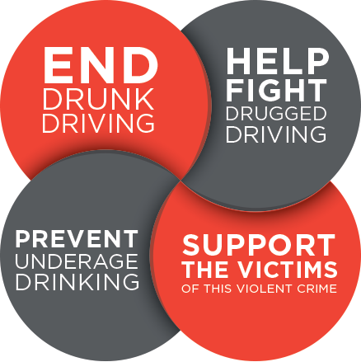
MADD’s Mission: NO MORE VICTIMS
Notes:
To create a future of No More Victims, MADD’s work is evident through four mission areas:
End drunk driving
Help fight drugged driving
And prevent underage drinking
Support the victims of this violent crime
If you know someone who has been impacted by these crimes.
1-877-MADD-HELP is a 24-hour Victim helpline

Slide 3
MADD’s Underage Substance Use Prevention Programs
Notes:
Specifically addressing the prevention of underage substance use, MADD recognizes that it takes both parents and children to tackle this problem and be part of the solution. We have a curriculums for youth 18 and under- Power of Me! which is designed for 4th and 5th graders, Power of Youth Middle School, and Power of Youth High School along with this evidence-based Power of Parents presentation.
In 2023, Power of Parents earned the esteemed title of “evidence-based” when previously it was a “research-based” program. To explain simply, that means the program was built based on solid research and, as time went on, multiple evaluations were completed to prove the effectiveness by measuring the relationship between the program and its outcomes.

Slide 4
National Presenting Sponsor
Notes:
Nationwide is the National Presenting Sponsor of Power of Parents, without whom MADD would not have this program.

Slide 5
Today’s Key Objectives
Problem and consequences of underage drinking and Cannabis use
Role of teens’ friends/peers
Role of adults
Role of parents
What you can do today, tomorrow, and in the future to keep your kids safe
YOU Have The Power
to Make a Difference!
Notes:
Today, we’re focusing on the Power of Parents program and will talk about…
The problem and consequences of underage drinking as well as cannabis use (or more commonly referred to as Marijuana use).
The role of teen’s friends and peers
The role of adults
The role of parents
And what you can do today, tomorrow, and in the future to keep your kids safe.
To be respectful of your time, please hold your thoughts and questions until the end. I am happy to stay afterwards and would love to hear from you.

Slide 6
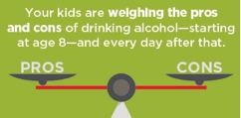
Underage Substance Use Problem
and Consequences
Alcohol is a drug.
While cannabis and opioids are concerning for young people, alcohol continues to be the number one drug of choice among youth.
Teen alcohol use kills more than 4,300 youth each year.
Kids who start drinking young are seven times more likely to be in an alcohol related crash.
Notes:
6
Parents often rank drugs as more dangerous than alcohol. However, alcohol is a drug, and the drug that is most commonly used by youth.
1.Underage drinking kills 4,300 youth every year, and alcohol is more used among youth than cannabis or any other illicit drug combined.
2.Studies show that children are weighing the pros and cons of drinking as early as age 8.
3. If we wait until they're in college to have these conversations, we've waited too long.
4. National surveys show that the earlier someone becomes intoxicated, the higher the Chances of developing an alcohol dependence in college, which can lead to decisions like drinking after driving, riding with an impaired driver, or having unplanned, unprotected sex after drinking. The problem begins long before college.

Slide 7
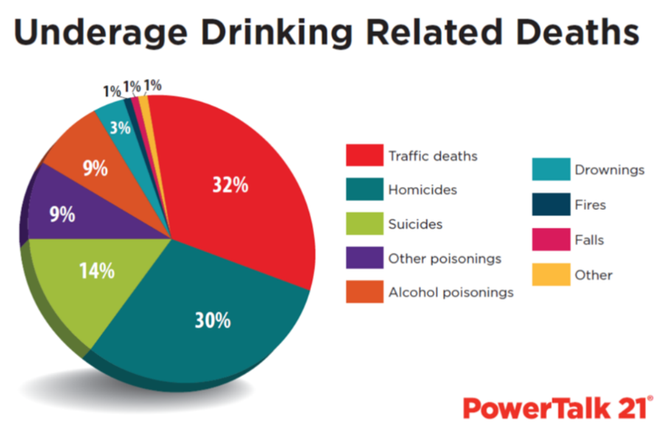
Taking Away the Keys… Doesn’t Take Away the Risks
Notes:
You may be primarily concerned about alcohol and your teenager as it relates to drinking and driving; this is a valid concern, but keep in mind that two-thirds (68%) of underage drinking related deaths are due to incidents other than traffic related causes.¹
(Click to reveal next graphic)
Alcohol contributes to deaths resulting from homicides, suicides, alcohol and other poisonings, drownings, fires and falls.
It is dangerous (and illegal) for teens to consume alcohol even if they are not driving. So as a parent, simply taking away the keys doesn’t take away the risks.
¹ Mothers Against Drunk Driving analyzed 2010 data from the FBI, the National Highway Traffic Safety Administration and the Centers for Disease Control and Prevention on deaths related to underage alcohol use. It estimates that 32% of these deaths were traffic fatalities; 30% were homicides, 14% suicides, 9% alcohol poisonings and 15% other causes.

Slide 8
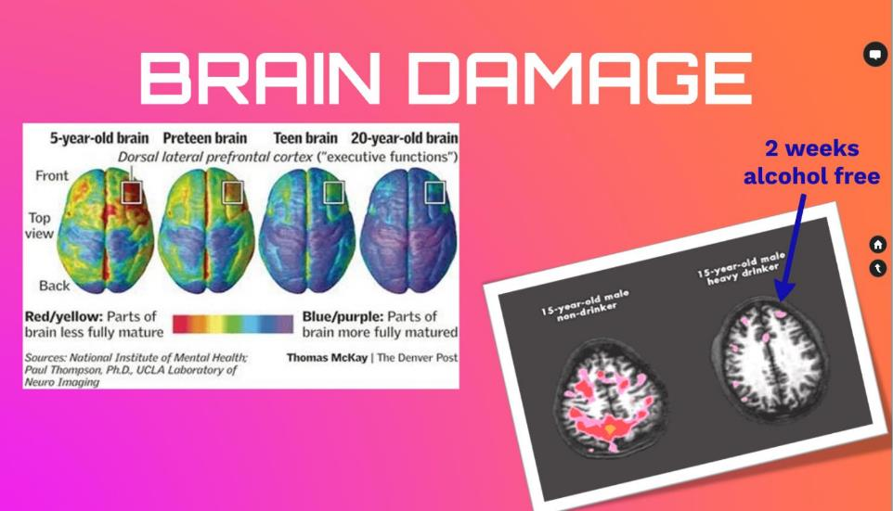
The Adolescent Brain
Notes:
During this time, the part of the brain that controls what are considered “Executive Functions” – for example being less emotional and more comprehensible, using judgement, planning and critical thinking – is at a critical stage and is not completely developed until their early to mid 20s.
This photo is a depiction of the development of the human brain. You can see from left to right the development from a 5-year-old brain to a 20-year-old brain. The different colors represent levels of maturation. You can see that 20-year-old brain is still developing. You can also see the extreme amount of development that happens from pre-teen to 20 years of age. The frontal and pre-frontal cortex (that controls judgment, planning, decision making, self- control) develops last.
Here you also can see how drinking on a regular basis can damage some memory and learning capacity. The brain you see on the right is a “heavy drinker”. The brain on the left belongs to a 15-year-old non-drinking male. Their brains were scanned as they were preforming identical memory tasks. You can see the brain on the left is much more active. The color indicates areas that are working to problem-solve. Do you notice any difference between the brain on the right and the left? (Pause for answers) Yes, the right brain is much less active.
Something else to notice is that the heavy drinker was two weeks alcohol free at the time of the scan, which shows alcohol can have a lasting effect on the brain.

Slide 9
The Role of Friends/Peers
Middle and high schoolers tend to overestimate how many teens drink alcohol and how much alcohol is consumed by their friends/peers.
“Everyone is drinking” when in reality the majority of teens don’t drink
Teens may know the potential risks of drinking and/or using cannabis, but think, “My friends drink and use cannabis and nothing bad has ever happened.”
Notes:
Parents worry about peers giving their kids alcohol or a group of friends applying social pressure to their kid to drink. Research shows that the larger issue relates to an over inflated perception that “Everyone is Drinking”. Middle and high schoolers tend to overestimate how many teens drink alcohol and how much alcohol drinking is done by their friends/peers. These misperceptions can lead to the belief that it’s normal to drink underage, and you must drink to fit in, and this ultimately leads to more teen drinking.
25% of eighth graders have tried alcohol and 1 out of 8 teens binge drinks; this means THE MAJORITY OF STUDENTS DON’T EVEN DRINK.
Parents will never know who their Teens are being around 24 -7. Parents need to redirect and focus on what the real problem is correcting misinformation and changing our kids’ perceptions as well. Teens may know the potential risks of drinking and using cannabis but believe “Nothing Bad will happen to me. ”because my friends look find. Do not assume that giving information or statistics is enough to convince your teen not to drink or use cannabis.

Slide 10
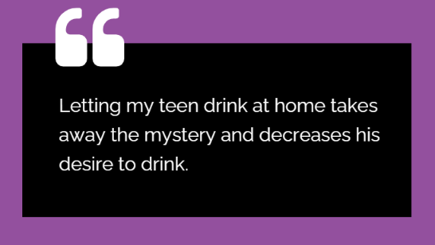
The Role of Adults
Some of the misperceptions of adults are:
Notes:
There are adults who think that allowing kids to drink small amounts of alcohol in the home will “teach” them to drink safely…
Letting teens drink at home takes away the “mystery” of alcohol and decreases teens’ desire to drink.
Or It’s okay to provide alcohol to underage teens for special occasions and holidays
Parent say they drank underage and/or used cannabis as a teen and turned out okay, so it’s fine for their kids, too.

Slide 11
The Role of Adults
Decades of research consistently prove that:
Children/teens permitted to drink in the home, even in small amounts, do this outside of the home:
You can’t teach your child/teen how to drink responsibly.
Drink More
Drink More Often
Have More Problems
Notes:
It is important for adults and parents to know multiple studies, in both the United States and Europe, have consistently shown that kids who are permitted to drink in their homes, drink more often and in larger amounts outside the home when their parents are not around. And they experience more serious problems.
There are no other drugs that adults would consider giving to kids in supervised settings that lower their risk of using it outside the home that have such a big impact on brain function. For example, most adults would not think of giving kids pain killers or cocaine in small doses in the home to let their kids experience the effects, yet many do this with alcohol.
You can’t teach your child or teen how to drink responsibly.

Slide 12
What YOU can DO
3 in 4 teens say their parents are the leading influence on their decisions about drinking alcohol.
Handbooks:
Middle school
High school
English and Spanish
madd.org/powerofparents
Notes:
12
Remember that 1 in 8 teens binge drinks? However, only 1 in 100 parents believe their child binge drinks. ¹ Research supports the idea that parent communication about alcohol can have a tremendous impact on the prevention and reduction of underage drinking.
This is why MADD partnered with Dr. Robert Turrisi, from Pennsylvania State University, to adapt his research to empower parents to have effective conversations with their middle and high schoolers about drinking. Dr. Turrisi’s original handbook was shown to reduce underage drinking by up to 30 percent among college freshman whose parents read and used the handbook.³
Dr. Turrisi’s research was proven to be highly effective in 2023 when the Power of Parents program was deemed “evidence-based”. Meaning, there is evidence from evaluations that prove his theory is true.

Slide 13
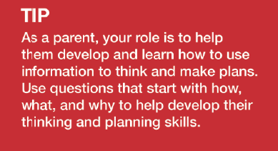
Topic: Your Middle/High Schoolers World
Teens think in the “here and now”
Teens desire freedom, independence and responsibility
They encounter new moral dilemmas about risky behaviors, alcohol, cannabis, and other drugs
Notes:
13
Teens hang in a fine balance between desire for freedom and independence and the maturity and they have the capability of handling both. Understanding how adolescent development, social pressures, increasing freedoms, and identity and self-esteem affect how they think about alcohol is important. Teens often think in the ‘here and now’ regardless of consequences; they are also strongly influenced by their peers, so good decision making is challenging for them.
As a parent your role is to help them develop and learn how to use information to think and make plans. This handbook provides insight and tips on how to help your teen become a better problem solver and decision maker, given all the different changes that are going on as they transition from children to young adults. As a parent or caregiver, you can communicate and model behavior in a manner that aids this process.

Slide 14
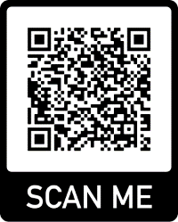
Topic: What Style of Parent are You?
PARENTING STYLE | ATTRIBUTE
Authoritarian | Parent gives orders; “my way or the highway”
Overprotective | Parent stays in control; parent rushes in & teens do not face consequences of actions.
Permissive Rule Setting | Parent gives in; “kids will be kids”
Positive/Authoritative | Use their authority to strengthen and protect (not control) the teen. Build trust and teach teen skills to make decisions.
Notes:
14
Parents rely on certain strategies for raising their children. Research shows these parenting styles fall in to one of four basic categories. If you are curious what your parenting style might be, use the camera on your smart phone to scan this QR-Code and take a short quiz. This slide provides an overview of how parenting styles impact underage drinking.
.
[However, it is important to note that the focus is not to paralyze parents into thinking their style is not good or bad, but rather to provide the evidence from the research and let parents choose the style that is best for their family.]

Slide 15
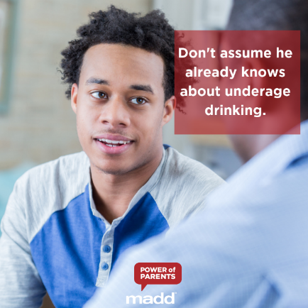
Topic: Talking About Alcohol
Techniques for having the conversation about alcohol
Knowing how to communicate family values and consequences
Handling questions about parents’ own history of underage drinking
Notes:
15
The handbook provides techniques for parents to have conversations with their teens about alcohol and the importance of setting clear and appropriate rules and consequences about alcohol. Some parents think that teaching overall values is enough, but it is very important to have specific and ongoing conversations with your teen about alcohol. Lack of knowledge.
The handbook also addresses how to handle questions about parents’ own history of underage drinking in this section.

Slide 16
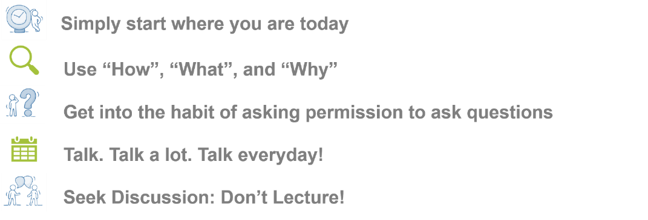
Starting the Conversation
Notes:
Here are some tips to starting a conversation with your teen about drinking and cannabis use that you can find in our handbooks.
Simply start where you are today. Many times, the conversation takes more than on resting on and processing. It will develop over time. As the parent, you must be an active participant in starting the conversation. Suggest that you’d like to talk. Don’t expect them to agree. Many teens will respond negatively or neutrally.
Start with “How”, “What”, and “Why” questions. This can help encourage an exchange of ideas and thought-provoking discussion with your teen.
Get into the habit of asking permission to ask questions. It sets the stage where you will work together to solve problems, instead of the conversation being one-way. It’s important to respect how your teen may feel and not force communication at a bad time. Let it drop and bring it up later. Try to pick a time when your child will be open to talking.
For example, not at bed-time it can wait.
Talk. Talk a lot. Talk everyday. Talk about things that matter to your teen. Ask questions and seek to understand. This makes conversations a normal part of interactions and when the time comes to discuss “heavier” topics like alcohol and cannabis, things will flow much easier.
Seek Discussion: Don’t Lecture! Share your own experience and opinions and how they have changed over the years. As you open-up and share experiences, so will your child.

Slide 17
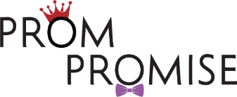
Place a special emphasis on these conversations during milestone times for your teen
Make the Prom Promise with your high school junior or senior today!
Promise to have a substance-free prom
Discuss safe rides home
Agree on consequences if promise is broken
Download the Prom Promise Contract from our website: https://madd.org/power-of-parents/
Notes:
Make sure your teen remembers their prom night- and makes it home safely!
The time is NOW to talk with your teen: the only way to guarantee a safe prom night is by having a substance-free prom night.
Make sure they understand the risks of underage substance-use and riding with an impaired driver
Help them have a plan ready for their prom night and how they are getting home
Come together to sign the Prom Promise Contract- agreeing to a substance-free prom and what the consequences would be if they were to break this promise!

Slide 18
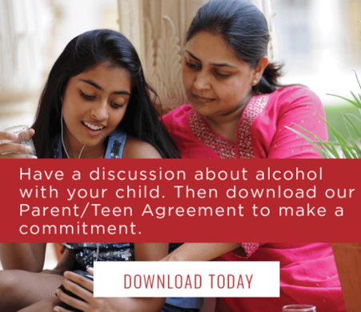
Topic: Helping Your Teen Make Good Choices
Tips for dealing with peer pressure
Finding alternatives to drinking
Guiding them to choose friends wisely
Set clear expectations, rules and consequences so your teen knows how you expect them to handle situations
Getting help when teenagers have a drinking problem
Notes:
When it comes to dealing with peers, your teen will need some pointers as to how to respond to the pressure to drink.
This section of the handbook also gives alternatives to discuss with teens for the reasons they think they may need to drink, such as “if the Reason to drink alcohol is to celebrate”; “Use Alternative like celebrate by going out to dinner with some friends.”
“Remind them, it is illegal for teens to drink alcohol, and it is illegal for teens to drink any amount of alcohol and drive (and MADD supports a zero-tolerance approach to underage drinking). It is important for parents to set clear rules and consequences around drinking before the age of 21, including never riding in a car with any driver who has been drinking. Discuss alternatives.
Finally, there is a section in the handbook for parents who fear their child might already have a drinking problem.
18

Slide 19
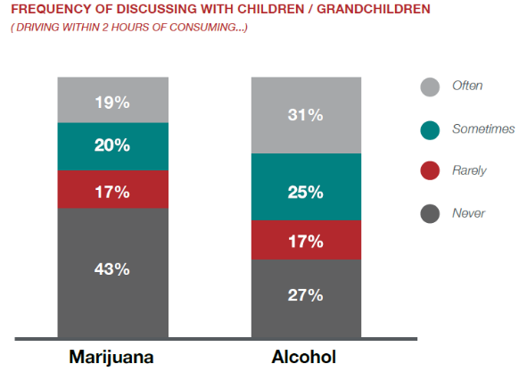
Helping Your Teen Driver Steer Clear of Driving Dangers
Talk to your child about the dangers and consequences of drinking and/or using cannabis and driving
Talk to your teen about the dangers of riding in a car with someone who has been drinking or consuming cannabis/other drugs
Create a plan on how to get home safe
Notes:
19
In February 2020, MADD commissioned a national study to better understand public attitudes and awareness when it comes to cannabis-impaired driving. Within the study, parents and grandparents were asked how frequently they discuss the potential consequences of driving after recently consuming both alcohol and cannabis.
As you can see in this chart just over 50% of parents and grandparents surveyed said that they discussed the consequences of driving after recently consuming alcohol with their teens “sometimes and often” compared to the startling 60% of parents and grandparents who said that they discussed the consequences of driving after recently consuming cannabis “rarely or never”. ²
The results of this survey reinforce the importance for parents and caregivers to have the intentional and ongoing conversations associated with the dangers of underage drinking and drug use along with the dangers of driving while impaired. It is important to discuss with teens the legal and physical outcomes of driving under the influence as well as riding with an impaired driver and create a plan on how to get home safe.
² https://www.madd.org/the-solution/drugged-driving-prevention/

Slide 20
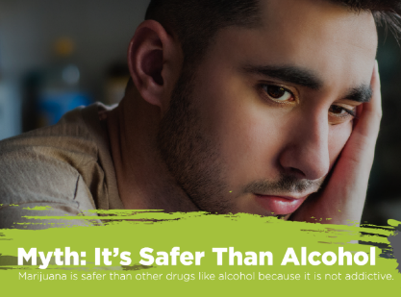
Topic: Talking About Cannabis and Combining Alcohol and Cannabis
There are differences in cannabis today vs. 30 years ago
It’s dangerous to the developing brain and studies have shown that the effects of cannabis on brain function cannot be reversed.
Debunk the myths youth may hold about cannabis
Notes:
20
We often get asked, what about cannabis, or other drugs? Next to alcohol, cannabis is the most misused drug among youth. And 1 in 3 youth who drink alcohol have also combined alcohol with cannabis on the same evening, and then experience 2-3 more problems as a result.¹ The science once again is clear and consistent, the earlier someone uses, the more danger that exists for their developing brain.
Research has shown teens who use cannabis are more likely to report decreases in brain volume, poorer attention, verbal skills and self-regulatory behaviors.
When it comes to cannabis, there are a lot of misconceptions. This section of the parent handbook outlines common myths teens and maybe even parents have about cannabis and the facts we now have from research.
conversations about drugs like cannabis as well as other drugs that may be current topics in your area. Reading this section, you’ll feel not only much more informed about the realities of young people and cannabis use today, but also much more equipped to communicate honestly and make decisions in your home that can make a difference in your child’s life.

Slide 21
Presentation Dedication
Olivia Pruett
Notes:
MADD dedicates each presentation in honor of a victim. These Mission Moments remind us why we’re talking about the prevention of underage drinking and the real-life families that have been affected.
Now I’d like to share the story of Olivia Pruett as told by her mother, Lisa.
My daughter Olivia didn’t wake up one day desiring to be an alcoholic and addict and lose her life at 21. That came about from the friends and choices she made.
Olivia took her first drink around age 13. Looking back, there were signs. Her friends changed in middle school; her diaries talk about how badly she wanted to fit in. I once dropped her off at a friend’s house and when I returned, she was so intoxicated with alcohol poisoning that we went straight to the emergency room.
Drinking caused Olivia to lose her virginity just before the 8th grade to a high school senior. Then she was so ashamed she drank more and tried to take her own life. Counseling helped for a while, but if she took one drink, she just couldn’t stop.
Olivia was a repeat offender: she got arrested, did drugs, wrecked a car, and became involved in an abusive relationship. Despite all the bad things, she still graduated early from high school with wonderful grades. When she wasn’t under the influence, she was sweet and charming and funny.
At age 21, Olivia called and asked for help. We got her wait-listed at an in-patient treatment program; she was supposed to call daily to check for an opening. But Olivia stopped calling, thinking she could handle it herself. Three months later, she drove drunk, hit an embankment, and died the next day.
Later I learned that the parents of one of Olivia’s closest middle school friends allowed kids to drink at home as long as no one was driving. I had no idea; I trusted other parents and put my head in the sand; I never wanted to believe that my daughter had a drinking problem or was less than perfect.
Losing Olivia changed our family forever. The simplest things you take for granted become a monumental event, like setting the kitchen table, just holding that extra plate in your hand.
I share her story because if one person chooses not to go down that same path, then Olivia’s life and death have purpose. That gives me comfort.
Olivia and countless others who have died and been injured as a result of underage drinking and drunk and drugged driving are the reasons why I am here with you today, and why MADD continues to work to save lives until there are no more victims. Whether your child is in high school or middle school, it is so very important for parents to have critical conversations with their kids about alcohol.

Slide 22
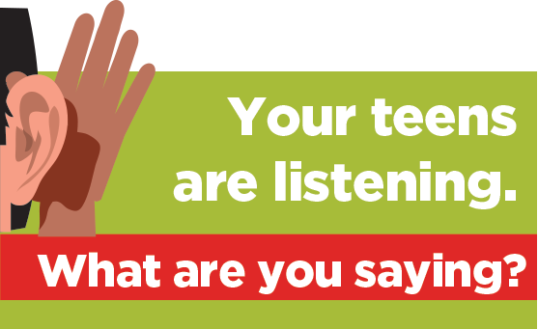
YOU Have the Power to Make a Difference
Notes:
To close:
First - Please take the time to read your parent handbook. It’s worth it and it works.
Second - If you haven’t started talking to your kids about alcohol, start now. Plan to have your first conversation with your kids, even tonight.
Third - Talk early, even starting at age 8 and keep talking through middle school and keep talking through high school! Frequency matters!
And finally, you DO have the power to make a difference and keep your kids safe. Remember that Research shows students of parents who take time to talk to their student about alcohol and other drugs and intervene when they notice a problem are less likely to use alcohol and other drugs. ¹
Your kids are listening. What are you saying?
1 Mallett, K. A., Turrisi, R., Ray, A. E., Stapleton, J., Abar, C., Mastroleo, N. R., Tollison, S., Grossbard, J., & Larimer, M.E. (2011). Do parents know best? Examining the relationship between parenting profiles, prevention efforts, and high-risk drinking in college students. Journal of Applied Social Psychology, 41(12), 2904-2927. PMCID: PMC3791594

Slide 23
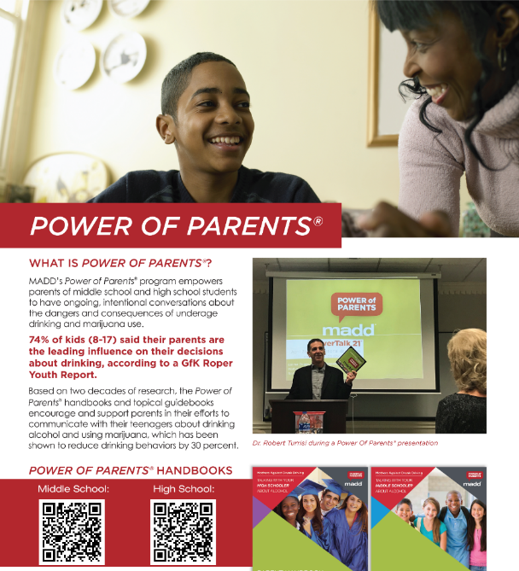
Notes:
Scan The QR Code for Handbooks

Slide 24
MADD-West Tennessee Program Specialist –Karon White
901-262-6819
Karon.white@madd.org
https://madd.org/power-of-parents/
Notes:
Thank you for allowing me to share with you MADD’s resources to help you keep your kids safe from the dangers of underage drinking. I hope you feel more empowered to influence your teen to make wise decisions. You’re free to leave, but I will be here to answer any questions you may have.
Optional: I am now going to hand out Workshop Post-Evaluation forms. Please take the next 5 minutes to complete this evaluation so that I can continue to improve my presentation and MADD can continue to improve the program content. When you are finished, I will collect your form and you are free to leave. I will be here if you have any additional questions.

