Slide 1
It’s Complicated
How a Marathoner Got Lung Cancer
Aaron Hawkins Shelby County ATOD Summit - April 26, 2024

Slide 2
Agenda
Background
My long history with tobacco
My (1st) diagnosis
My discussions and choices
What I learned (and unlearned)
My (2nd) diagnosis
My discussions and choices
What I learned (and unlearned)
Advocacy and making the world a better place

Slide 3
Background
History 1972 - 2003
My hometown
My ‘athletic’ history
My work history
My wife

Slide 4
My Tobacco History
When and why I started
How I could’ve stopped
At home and at work
What the actual cost was
Financial
Physical

Slide 5
My First Diagnosis
January 9, 2003
What happened
The first six months
Grieving
Medication
The CHANGE
Wife’s advice
Dentist
A massive reprioritization

Slide 6
Health and Advocacy
Marathoning and the National MS Society
I needed to change my outlook
Running
Directing my energy and focus
Raising money for a worthy cause

Slide 7
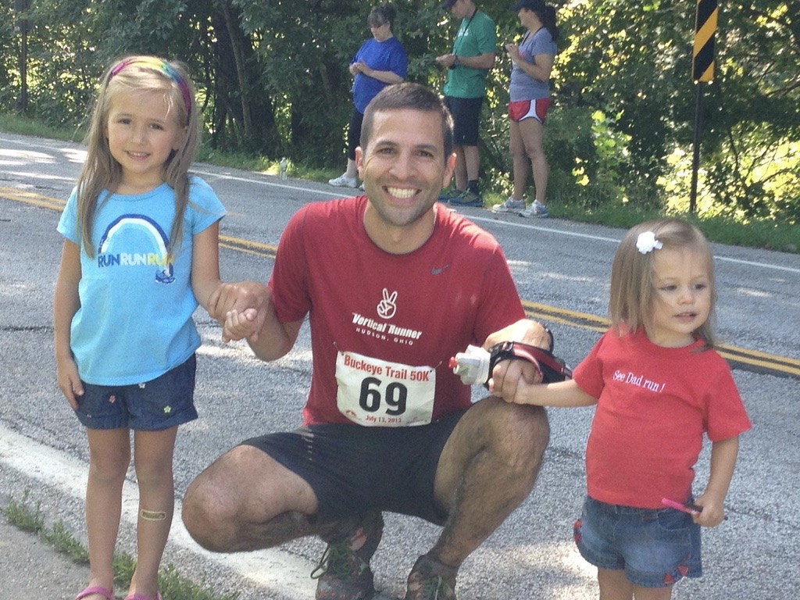

Slide 8
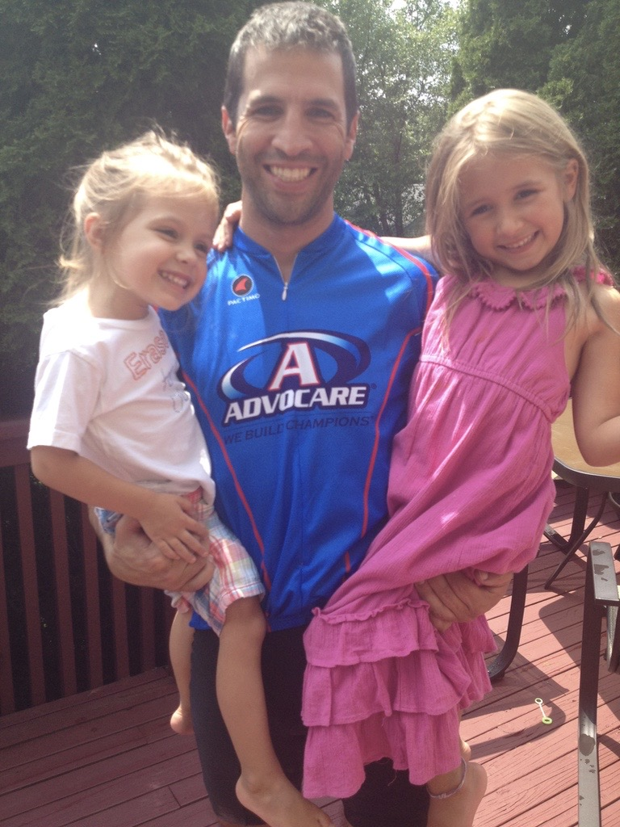

Slide 10
My Second Diagnosis
October 31, 2019
What happened
The first two weeks
My FIRST call
American Lung Association’s Fight for Air Climb
Marathon
Surgery
Afterward

Slide 11
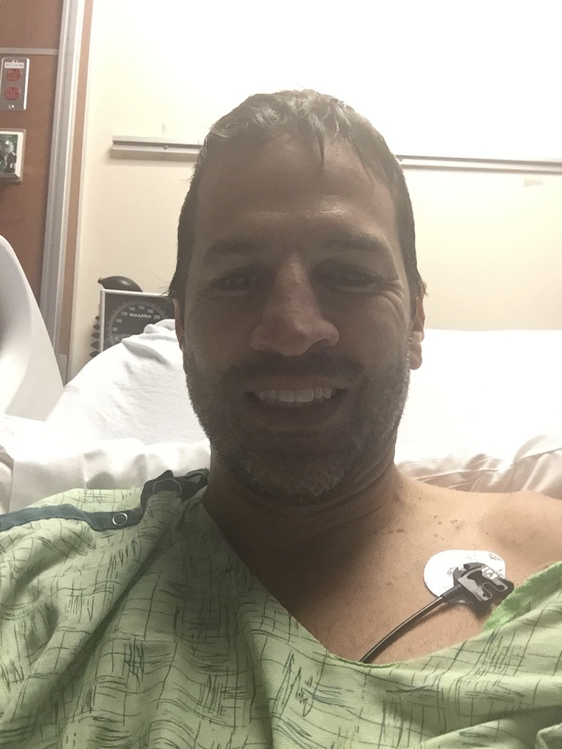

Slide 12
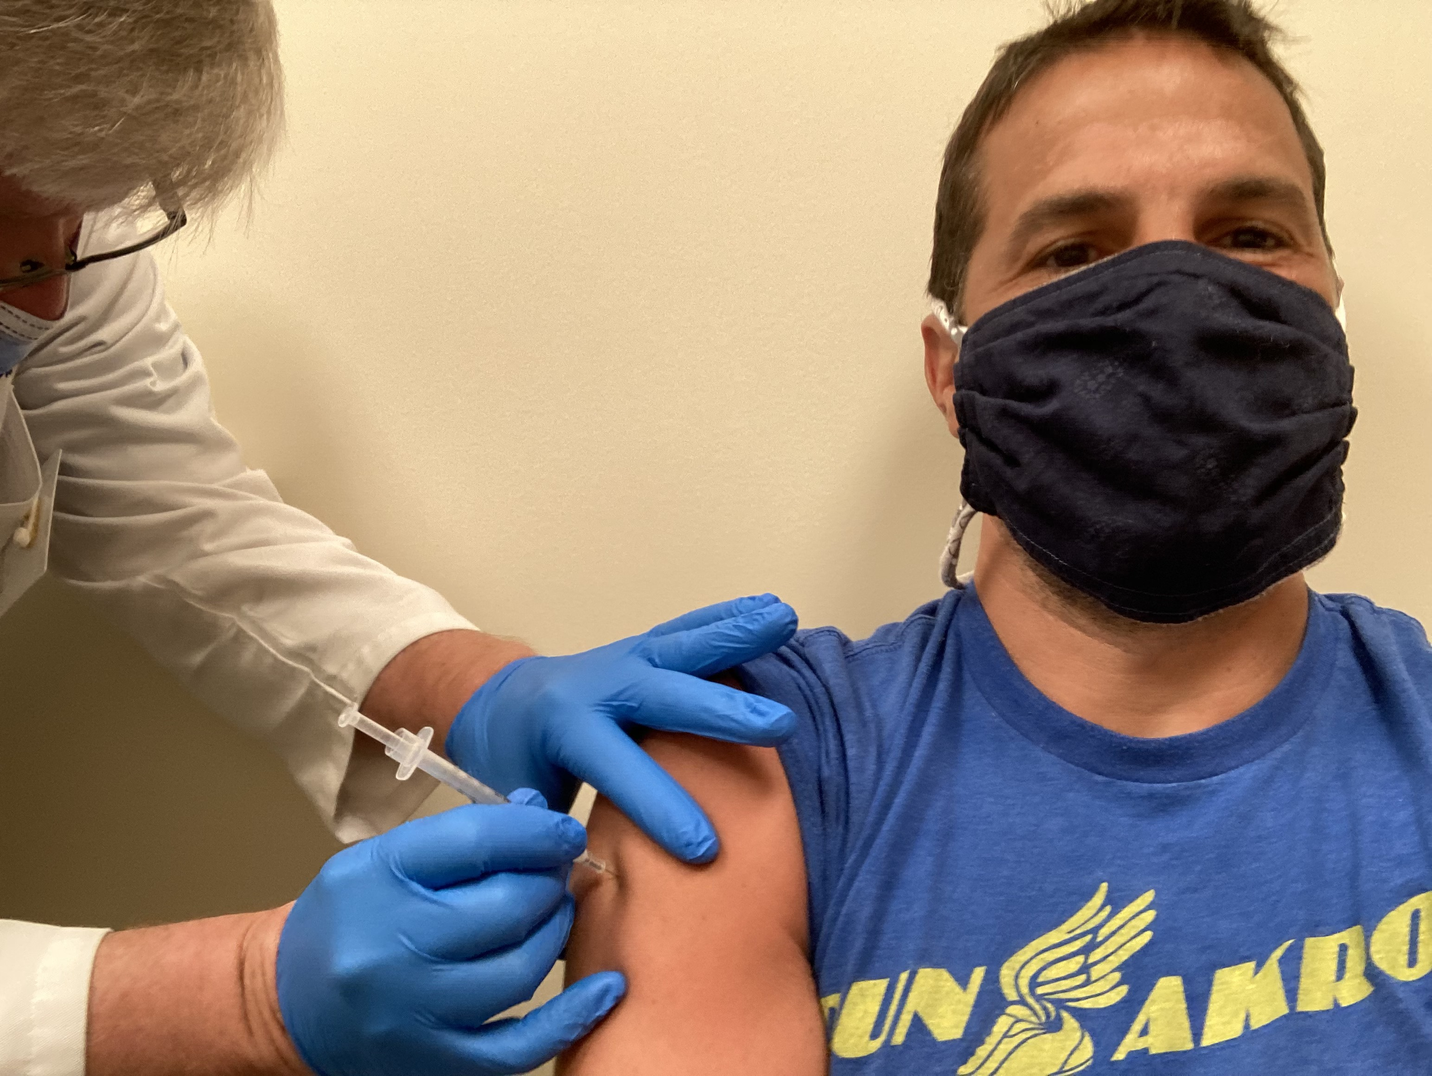

Slide 13
Health and Advocacy
Marathoning and the American Lung Association
Reinvigoration
Running
Taking Advocacy to another level
LUNG FORCE Advocacy Day
Local involvement
Again, raising money for a worthy cause

Slide 14
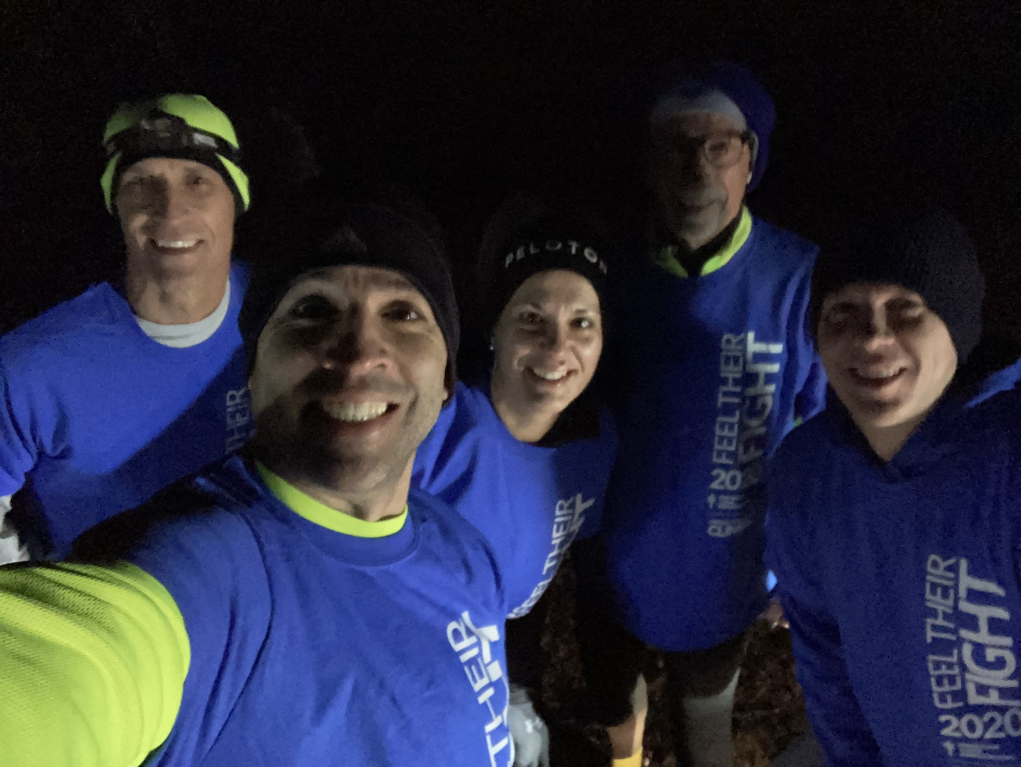
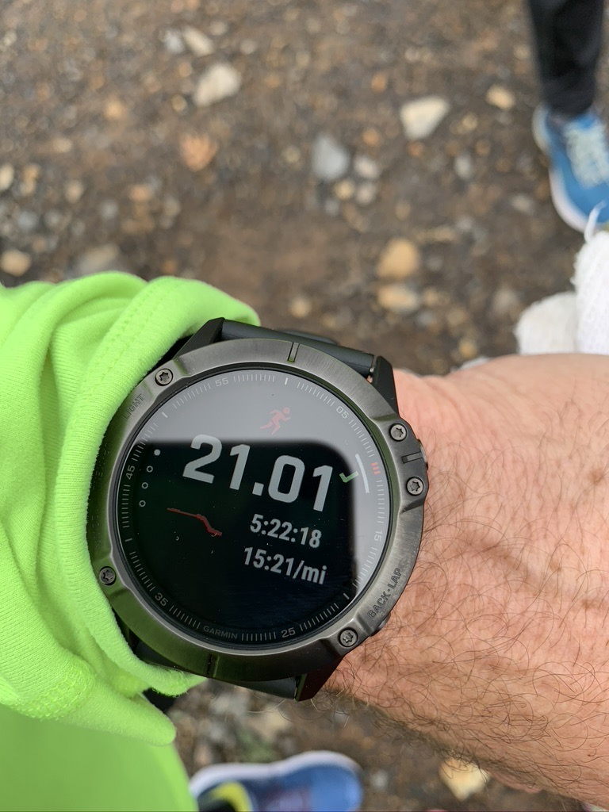
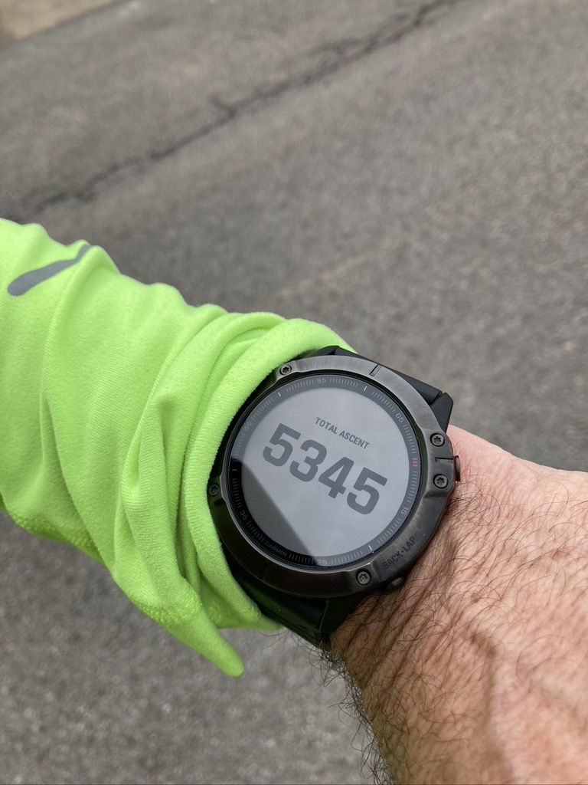

Slide 15
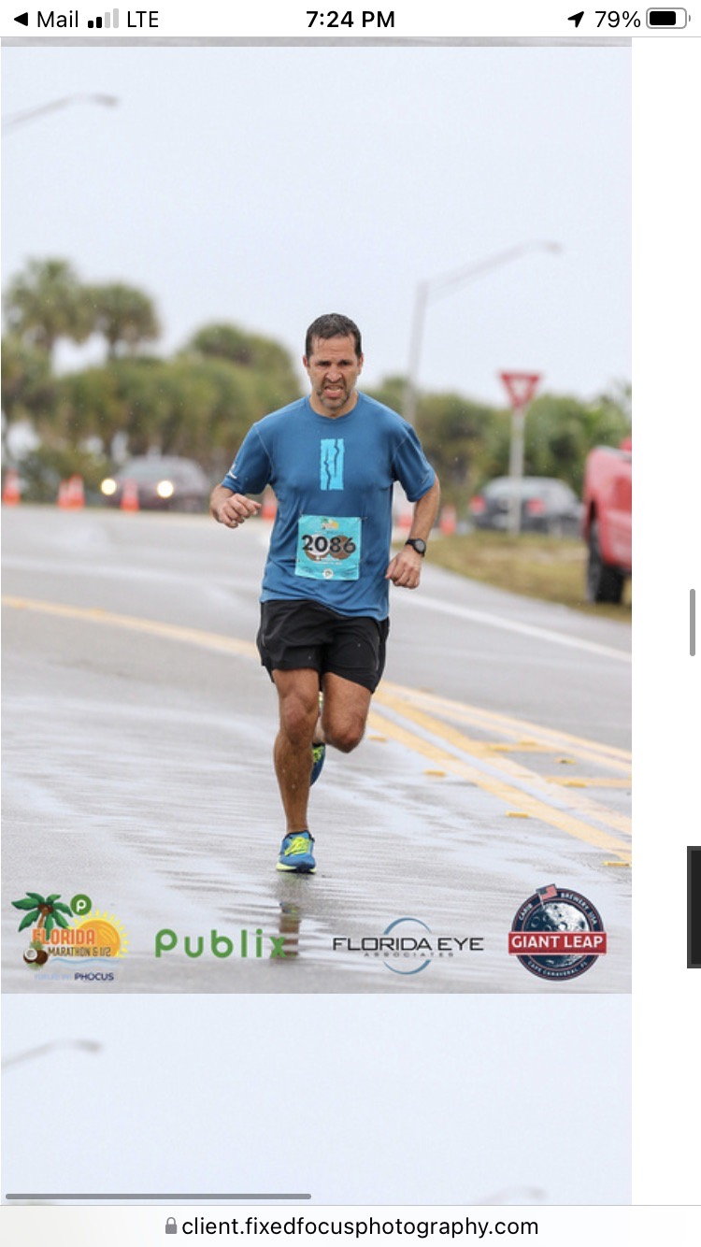
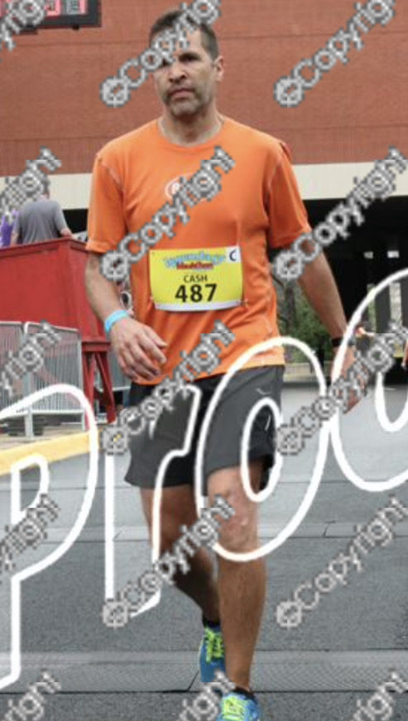

Slide 16
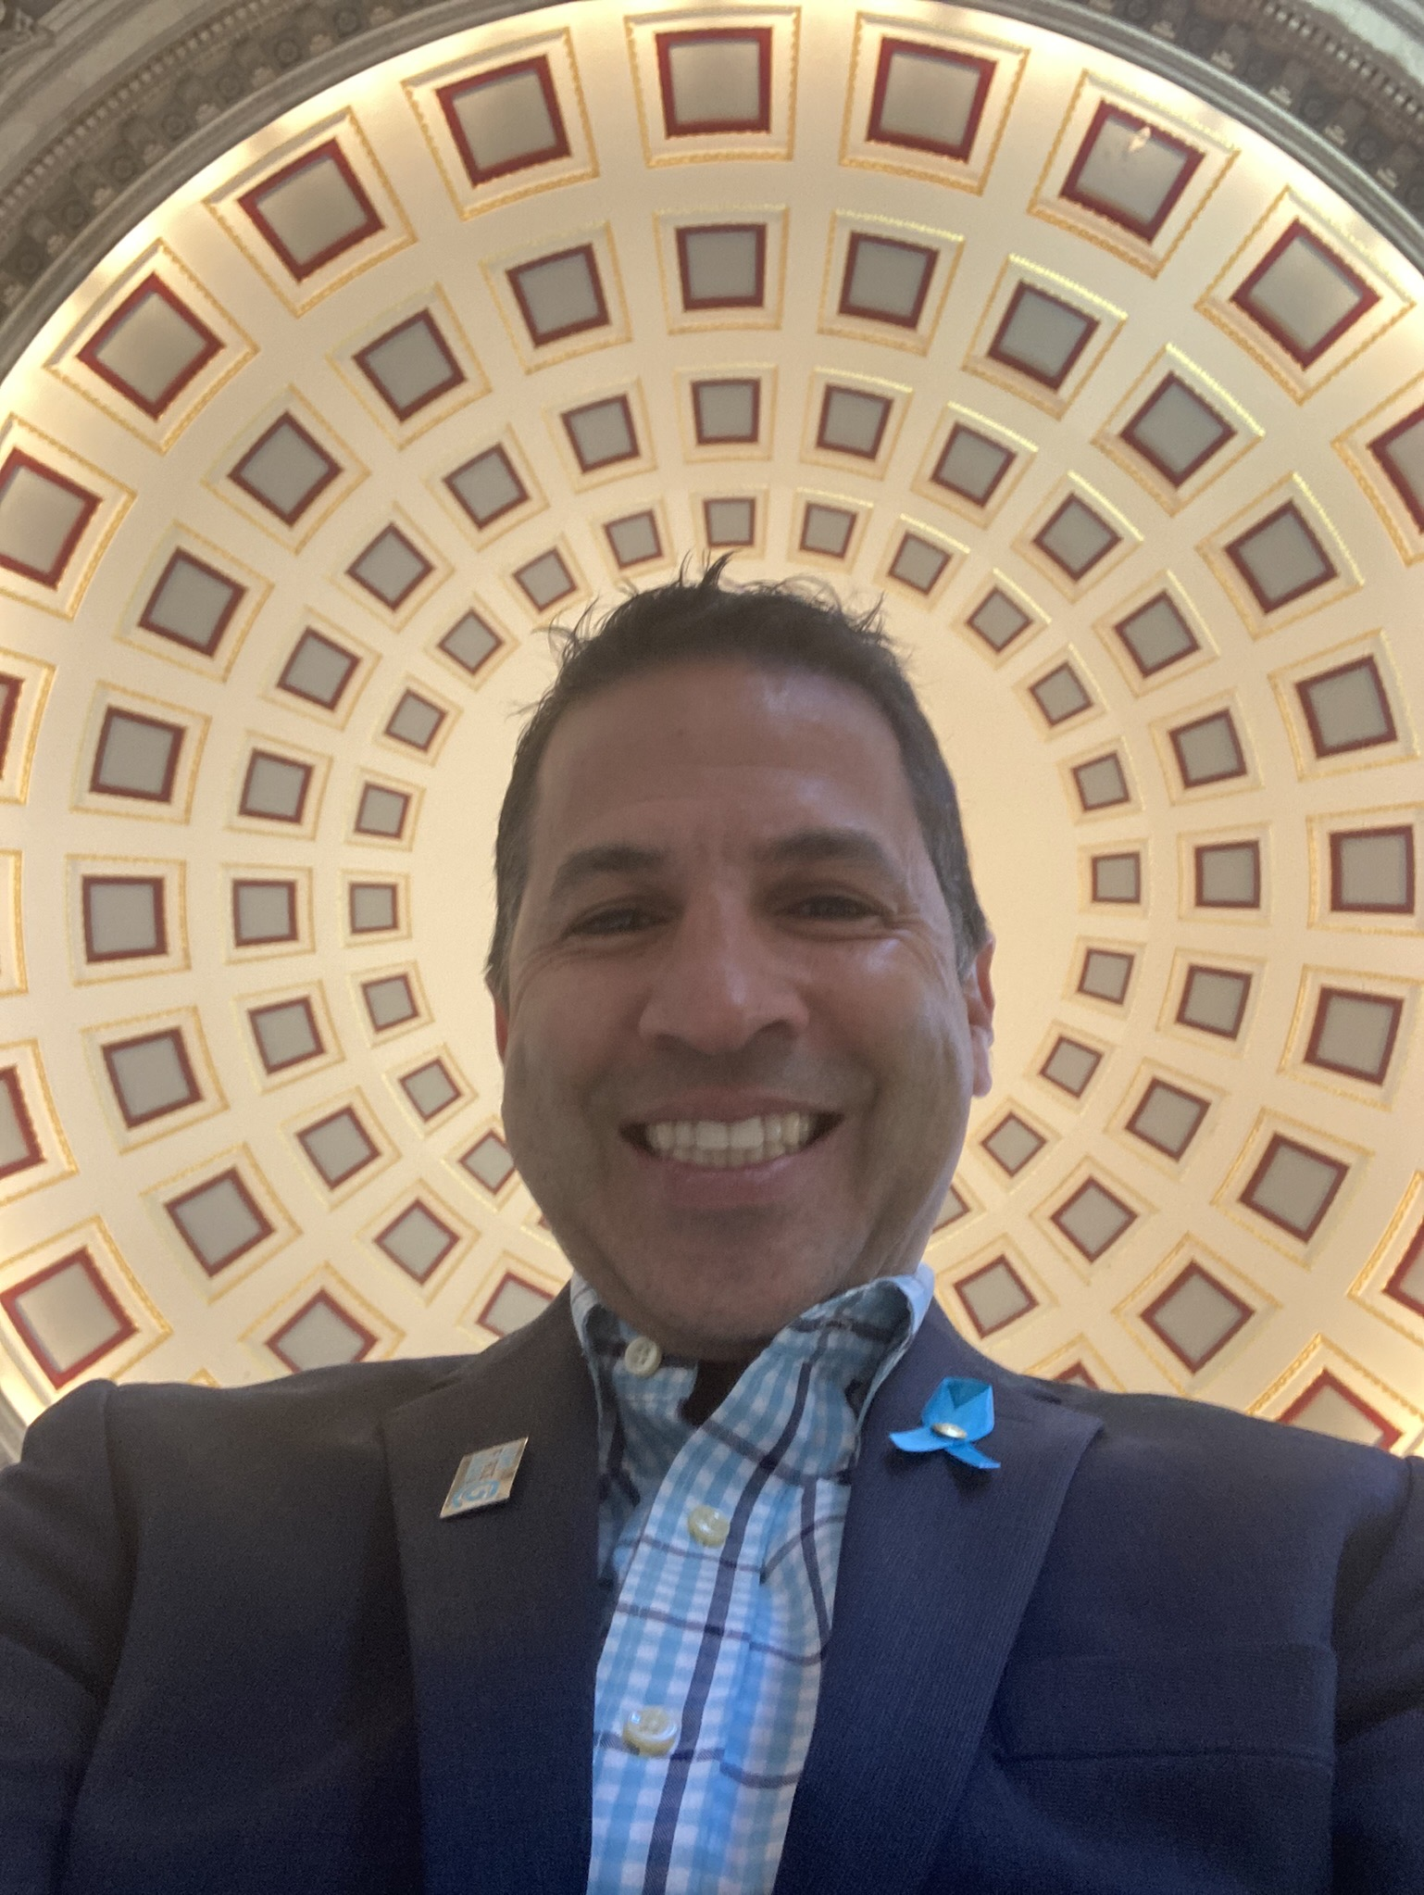
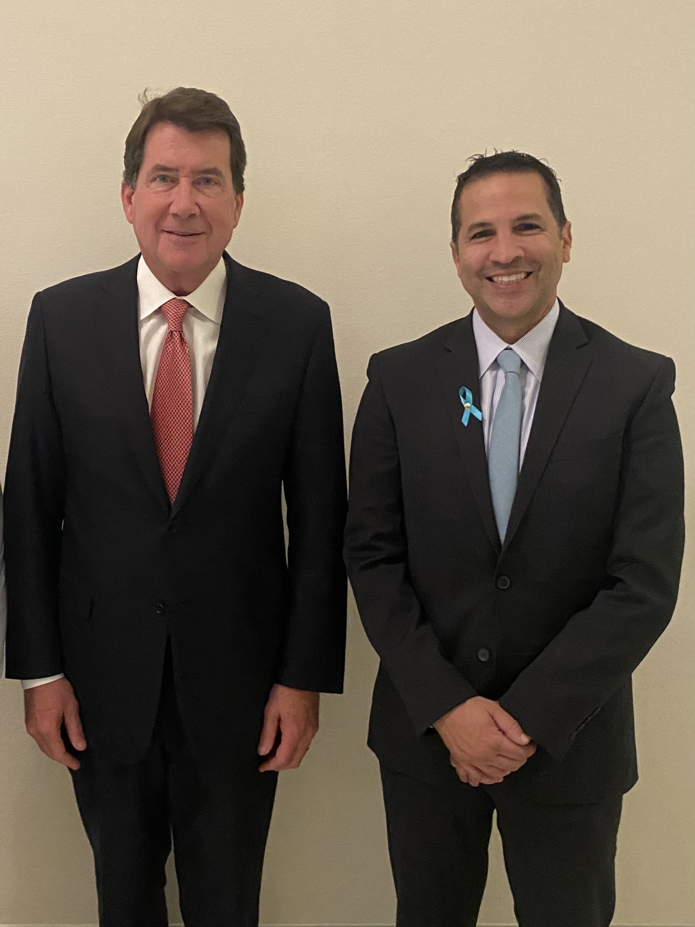
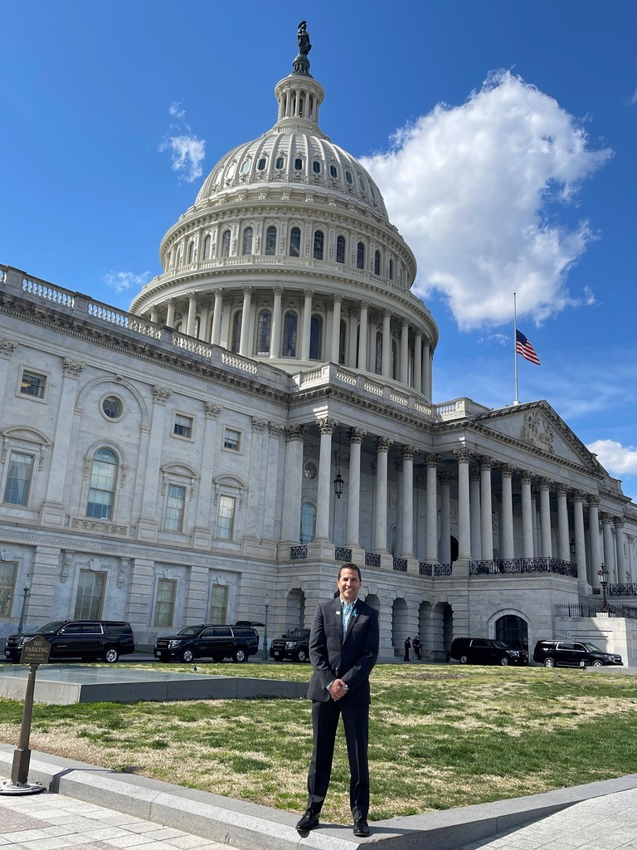
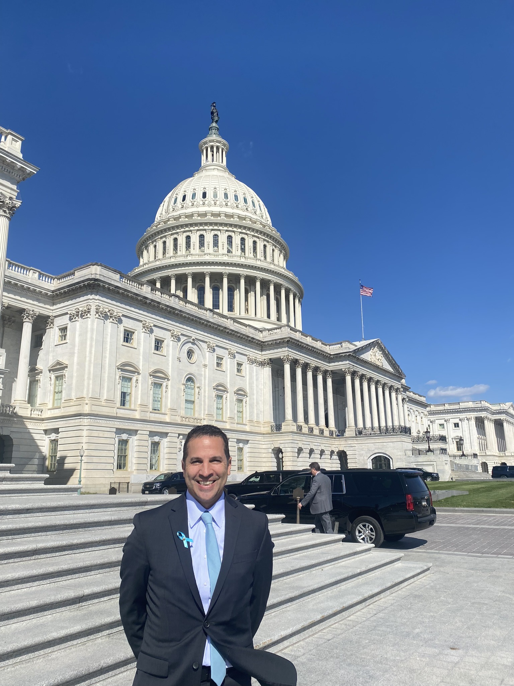
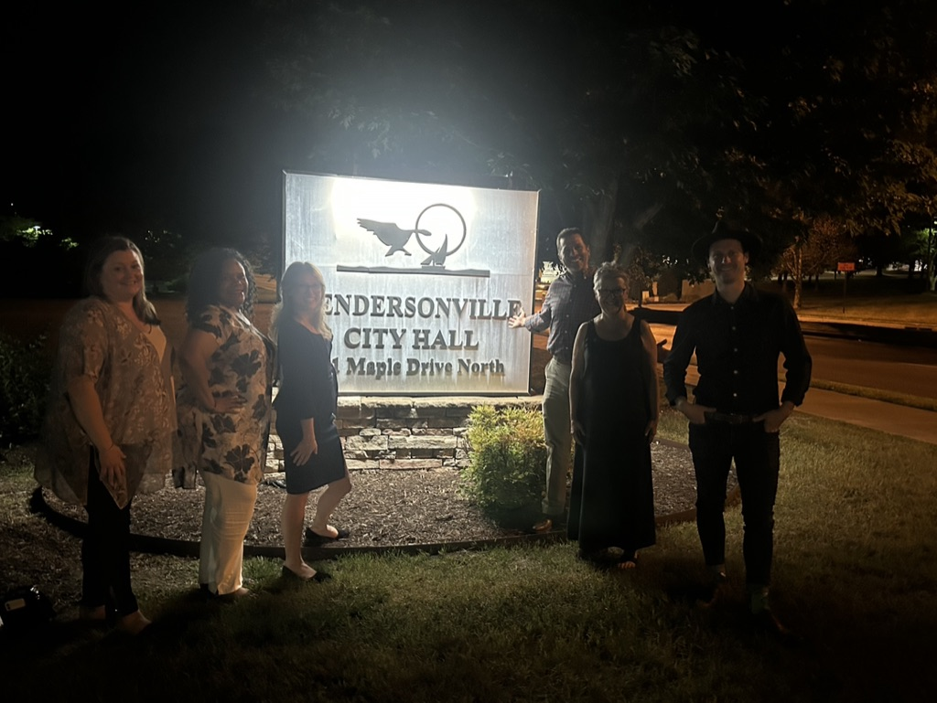

Slide 17
Advocacy
The American Lung Association
Just show up!
Get involved, stay involved
A little bit goes a long way
Fundraising
Board Membership
LUNG FORCE Advocacy Day
Hendersonville and Beyond!

