Slide 1
Gas Stations: The Next Pharmacy?
Erica Hurst, Pharm.D.
Assistant Chief Pharmacist
TDMHSAS

Slide 2
Objectives
Identify what might be available for purchase at a gas station
Understand how these substances work/affect the body
Understand how to educate and talk to patients about the risks and dangers associated with using these substances
Content Prepared by: Hanah Vitali, PharmD Candidate & Raquel Lockridge, PharmD Candidate

Slide 3
Accessibility¹
The NACS (National Association of Convenience Stores) states that there are 152,396 convenience stores in the United States
It is estimated there is one store per 2,240 people in the United States
120,061 of these convenience stores sell gas
On average, 1,100 individuals visit a convenience store daily
More than 400,000 individuals per year
Most gas stations are open late or even 24/7
Hannah Vitali, PharmD Candidate & Raquel Lockridge, PharmD Candidate

Slide 4
Gas-Rx^{2,5}
The term “gas station drugs” refers to a wide range of substances typically available for purchase from gas stations, corner stores, bodegas, mini marts, smoke shops, and the Internet
These substances may be produced commercially by drug manufacturers or in clandestine laboratories to mimic the effects of more well-known illicit/controlled substances such as marijuana, cocaine, opioids, etc.
The loopholes they use are usually sold by include being labeled as “dietary supplements”, “nutritional supplements” or “not for human consumption”
Hannah Vitali, PharmD Candidate & Raquel Lockridge, PharmD Candidate

Slide 5
Regulation³
Gas stations have no regulatory process for approval of drugs
If the drug is marketed as a dietary supplement it should meet the Dietary Supplement Health and Education Act (DHSEA) requirements
Raises concerns due to unknown composition of substances, misleading claims, and hidden risks such as adverse interactions
The lack of FDA oversight means there is no guarantee of the purity, potency, or safety of these products
Hannah Vitali, PharmD Candidate & Raquel Lockridge, PharmD Candidate

Slide 6
Dietary Supplement Criteria⁴
Dietary Supplement is a general umbrella term that includes herbals, vitamins, minerals and many substances that are not plant derived but exist in nature.
FDA loosely regulates dietary supplements, but does not evaluate safety and effectiveness
Dietary supplements are regulated by DSHEA of 1994
DSHEA requires the manufacturer to ensure that their products are safe before they are marketed
Once marketed the FDA must show it is “unsafe” before it can restrict or remove it from the market
Hannah Vitali, PharmD Candidate & Raquel Lockridge, PharmD Candidate

Slide 7
Commonly Found Drugs
Tianeptine
Kratom
Whippets
GHB
Delta 8
Poppers
Hannah Vitali, PharmD Candidate & Raquel Lockridge, PharmD Candidate

Slide 8
Tianeptine
Hannah Vitali, PharmD Candidate & Raquel Lockridge, PharmD Candidate

Slide 9
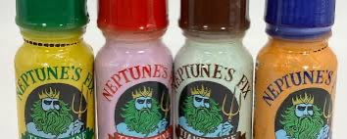
Tianeptine Background⁵
Tianeptine is Schedule II antidepressant agent
Schedule II: High potential for abuse with potential to cause severe psychological or physical dependence
Also known as “Gas station Heroin,” “ZaZa Red,” “Neptune’s Fix”
Increases serotonin uptake in the brain and reduces stress
It binds to the same receptors in the brain as heroin and fentanyl, causing similar euphoric and addictive effects
Hannah Vitali, PharmD Candidate & Raquel Lockridge, PharmD Candidate

Slide 10
Tianeptine Uses⁵
Not FDA approved for medical use in the United States
Used to treat major depressive disorder in European, Asian and South American countries
Used to self-treat anxiety, depression, and irritable bowel syndrome
Marketed as a supplement, at higher doses acts as an opioid receptor agonist
Symptoms of tianeptine withdrawal are similar to those of opioid withdrawal, including agitation, nausea, anxiety, diarrhea, and chills
Hannah Vitali, PharmD Candidate & Raquel Lockridge, PharmD Candidate

Slide 11
Tianeptine Concerns⁵
Poison control center cases involving tianeptine exposure have increased nationwide, from 11 total cases between 2000 and 2013 to 151 cases in 2020 alone
In November 2023, the FDA raised additional concern over theses products
“FDA is warning consumers to not purchase or use any Neptune’s Fix products, or any other product with tianeptine—a potentially dangerous substance that is not FDA-approved for any medical use but is illegally sold with claims to improve brain function and treat anxiety, depression, pain, opioid use disorder and other conditions.”
Nine states have banned selling tianeptine over the counter
Alabama, Florida, Georgia, Indiana, Kentucky, Michigan, Mississippi, Ohio and Tennessee
Hannah Vitali, PharmD Candidate & Raquel Lockridge, PharmD Candidate

Slide 12
Kratom
Hannah Vitali, PharmD Candidate & Raquel Lockridge, PharmD Candidate

Slide 13
Kratom Background⁶
Native to Southeast Asia as a tropical tree (Mitragyna speciosa)
Two main chemical components: mitragynine and 7-hydroxymitragynine
Hannah Vitali, PharmD Candidate & Raquel Lockridge, PharmD Candidate

Slide 14
Kratom Uses⁶
Often to used to self-treat pain, diarrhea, anxiety, depression, etc.
The effects of kratom is dose dependent
Stimulant effects are shown at lower doses and sedative effects are shown at high doses
Sale of the natural form is allowed, but synthetic alkaloids of kratom are currently banned everywhere
Synthetic alkaloids are compounds that have similar structures
Hannah Vitali, PharmD Candidate & Raquel Lockridge, PharmD Candidate

Slide 15
Kratom Concerns⁷
In 2016 the DEA published notice to make kratom a schedule 1 controlled drug
Schedule 1: drug with no accepted medical use and high potential for abuse
The DEA received immense backlash from this notice, which caused for the notice to be removed
The DEA listed kratom as a Drug and Chemical of Concern
Estimated 1.7 million Americans 12 years and older used kratom in 2021
Currently banned in 6 states
Alabama, Arkansas, Indiana, Rhode Island, Vermont, Wisconsin
There is an age restriction in 6 states (21 years old)
Georgia, Illinois, Minnesota, South Dakota, Tennessee, West Virginia
Hannah Vitali, PharmD Candidate & Raquel Lockridge, PharmD Candidate

Slide 16
Delta 8
Hannah Vitali, PharmD Candidate & Raquel Lockridge, PharmD Candidate

Slide 17
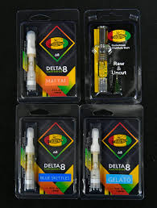
Delta 8 Background⁸
Δ-8-tetrahydrocannabinol is a psychoactive cannabinoid found in the Cannabis plant
Became legal in 2018 and is unregulated at the federal level
Sold at most gas stations
Age restriction in TN
Have to be 21
Comes in many forms at gas stations
Vape, gummies, tinctures
Hannah Vitali, PharmD Candidate & Raquel Lockridge, PharmD Candidate

Slide 18
Delta 8 Uses⁸
Delta 8 is used for relaxation, euphoria, pain relief, nausea and vomiting caused by cancer drug treatment, glaucoma, trouble sleeping, and many other conditions
There is no good scientific evidence to support these uses
Hannah Vitali, PharmD Candidate & Raquel Lockridge, PharmD Candidate

Slide 19
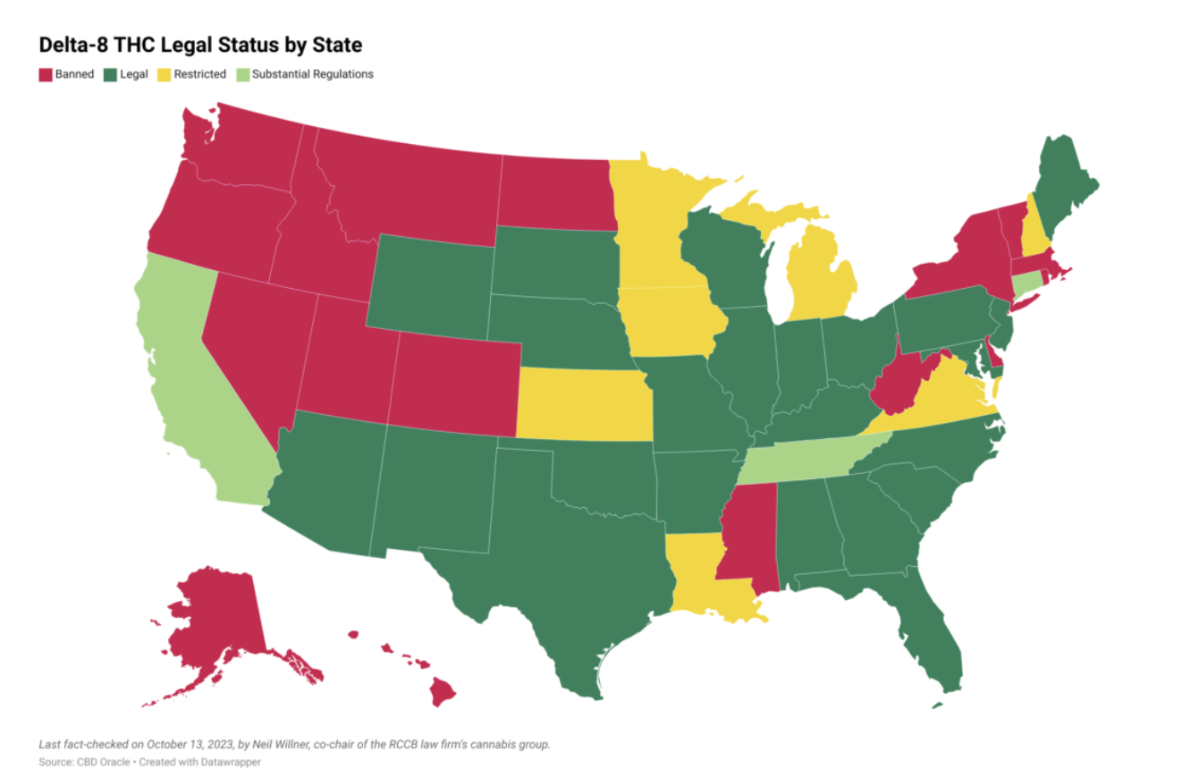
Legalization of Delta 8⁹
Legal in 22 states and 1 district
Banned in 17 states and severely restricted in 7 states
Hannah Vitali, PharmD Candidate & Raquel Lockridge, PharmD Candidate

Slide 20
Poppers
Hannah Vitali, PharmD Candidate & Raquel Lockridge, PharmD Candidate

Slide 21
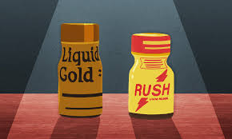
Poppers Background¹⁰
"Poppers" refers to amyl nitrite
Used in the medical field as a vasodilator to treat certain heart conditions
Recreational use emerged in the 1960-1970s due to euphoric effects and enhancement of sexual experiences
Often packaged in small bottles similar to energy shots
Can also be marketed as nail polish remover or cleaning products
Hannah Vitali, PharmD Candidate & Raquel Lockridge, PharmD Candidate

Slide 22
Poppers Uses¹⁰
Popper have psychoactive effects
It dilates blood vessels, leading to a sudden drop in blood pressure and increased blood flow to the brain
This leads to sensations of warmth or “high” effect, euphoria, heightened sensory perception, experiencing a temporary loss of inhibitions, or increased sexual arousal
Carry risks of headaches, dizziness, nausea, skin irritation, and in extreme cases, loss of consciousness or death
Prolonged use can cause irregular heart conditions, cancer, burns on skin if spilled
Hannah Vitali, PharmD Candidate & Raquel Lockridge, PharmD Candidate

Slide 23
Poppers Concerns¹⁰
Schedule VII in TN, any offense is a class E felony and punishable by a sentence of 1-2 years and $1,000 fine
Schedule VII: butyl nitrite or any isomer of butyl nitrite
Not considered physically addictive, they can be habit-forming, and chronic use may lead to tolerance and dependency
Harmful and potentially deadly drug interactions
Common blood pressure medications, heart failure medications and erectile dysfunction medications
Hannah Vitali, PharmD Candidate & Raquel Lockridge, PharmD Candidate

Slide 24
Whippets
Hannah Vitali, PharmD Candidate & Raquel Lockridge, PharmD Candidate

Slide 25
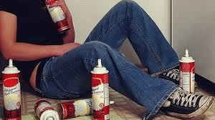
Whippets Background¹¹
Inhaled nitrous oxide that can be found in whipped cream aerosol canisters
Nitrous oxide is commonly called laughing gas
Used in medical practice for sedation and help people relax during procedures
Hannah Vitali, PharmD Candidate & Raquel Lockridge, PharmD Candidate

Slide 26
Effects from Whippets¹¹
Can cause psychiatric symptoms
Hallucinations, paranoia, etc
Prolonged use can lead to muscle atrophy and/or organ damage
This can cause brain cells to die as result of oxygen deprivation
Euphoric feeling only last a few seconds or minutes
This causes most individuals to repeat use relatively quickly
Hannah Vitali, PharmD Candidate & Raquel Lockridge, PharmD Candidate

Slide 27
Whippet Concerns¹¹
Doesn’t affect levels of dopamine or serotonin
It decreases oxygen and increased carbon dioxide in your body
The more you repeat use, the more oxygen is decreasing from your body
Not physically addictive but can be psychologically addicting
Psychologically addicting because of the “rush” the individual experiences
Certain states have created age restrictions (under 21 years old) on nitrous oxide canisters
Hannah Vitali, PharmD Candidate & Raquel Lockridge, PharmD Candidate

Slide 28
GHB
Hannah Vitali, PharmD Candidate & Raquel Lockridge, PharmD Candidate

Slide 29
GHB Background¹²
Gamma-hydroxybutyrate: Schedule 1
Known as "G," "liquid ecstasy," and "liquid X."
Usually sold as liquid or white powder that dissolves in water
Liquid form is clear, colorless and slightly salty in taste
More commonly known as a date rape drug which became popular in 1990s at clubs and raves
Hannah Vitali, PharmD Candidate & Raquel Lockridge, PharmD Candidate

Slide 30
GHB Uses¹²
Misused for euphoric and calming effects
Increases libido
Some believe it builds muscles and causes weight loss
Major cause for concern is that it can cause amnesia
If an individual is given or “slipped” this drug, they could forget a period of time and events that occurred
Can also produce hallucinations and excited or aggressive behavior
Hannah Vitali, PharmD Candidate & Raquel Lockridge, PharmD Candidate

Slide 31
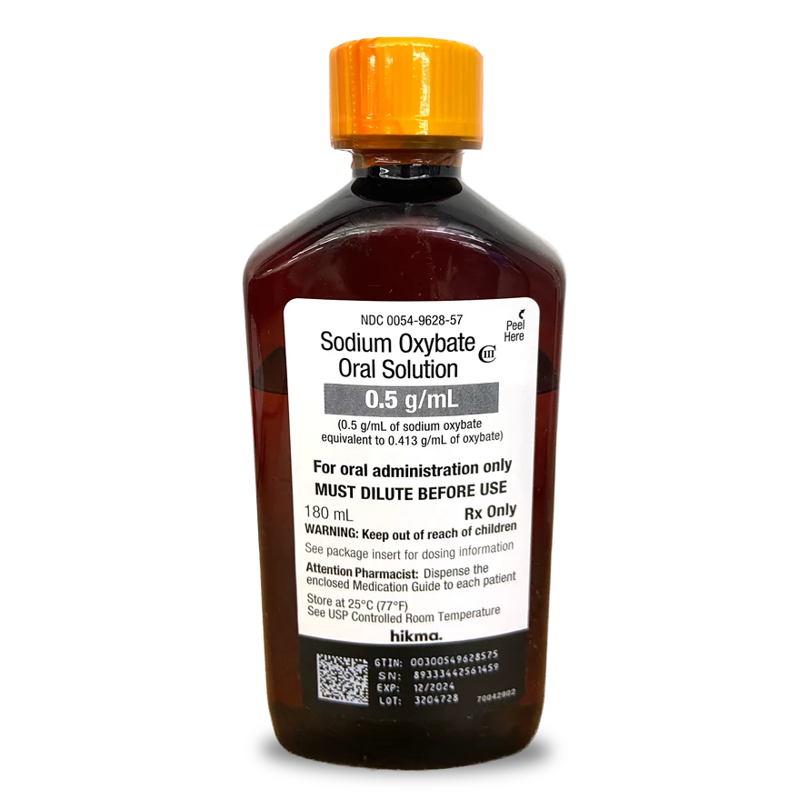
GHB Rx Form¹²
Sodium oxybate is another name for GHB
This is an FDA approved prescription medication used to improve daytime sleepiness and muscle weakness with narcolepsy
It is classified as a schedule III drug
Schedule III: drugs with moderate to low potential for physical and psychological dependence
Takes 15-30 mins for effect and last 2-4 hours
Taken multiple times throughout the night
Hannah Vitali, PharmD Candidate & Raquel Lockridge, PharmD Candidate

Slide 32
How Can We Help?
Talk to patients regarding the risks of these drugs
Remind patients that just because a substance is conveniently sold does not mean it is safe
Provide person-centered and trauma-informed care to patients, even if they are not ready to stop using
Carry naloxone and encourage its use when a person’s respiration is depressed, or if an opioid overdose is suspected. Though limited, there is some evidence that naloxone may have efficacy in treating tiapatine toxicity.
Educate patients on overdose risk-prevention strategies, such as avoiding mixing substances
Refer individuals to local harm reduction agencies or other trusted, community-based providers available to connect patients to needed resources (i.e., sterile syringes, overdose education, HIV testing, fentanyl test strips, etc.)
Hannah Vitali, PharmD Candidate & Raquel Lockridge, PharmD Candidate

Slide 33
How to Protect You and Your Family
Consumers should avoid all products containing these substances, including those claiming to treat an ailment or disorder. Talk to your health care provider if you need help with opioid dependence, depression, anxiety, pain, or other ailments. There are approved treatments for those and related conditions.
Help is available to treat opioid or other substance use disorders. Find state-licensed providers who specialize in treating substance use disorders and addiction at www.findtreatment.gov. Or call 1-800-662-HELP (4357).
The FDA has taken steps to protect people from unapproved products, including warning consumers that these substances are an unsafe food additive and not a dietary ingredient. We have issued warning letters to companies illegally marketing products as dietary supplements and unapproved drugs.
Hannah Vitali, PharmD Candidate & Raquel Lockridge, PharmD Candidate

Slide 34
Takeaways
Gas stations are easily accessible and loosely regulated by the FDA
They use a loophole by calling these life alternating drugs “dietary supplements”
It is crucial that the risks associated with these drugs are public knowledge
There is a reason why some of these drugs are banned from certain states
Abuse of these drugs not only impact the individual, but also their family and friends
It is necessary that these individuals and love ones know what resources are available for help
Hannah Vitali, PharmD Candidate & Raquel Lockridge, PharmD Candidate

Slide 35
Questions?
Erica.B.Hurst@tn.gov
615.218.7357

Slide 36
References
“Convenience Stores Offer More Convenience.” Convenience.Org, 2024, www.convenience.org/Research/Convenience-Store-Fast-Facts-and-Stats/FactSheets/Convenience.
Stevens, Darryl. “The Evolution of Gas Station Heroin and Other Drugs.” Maryland Addiction Recovery Center, 31 Jan. 2024, www.marylandaddictionrecovery.com/the-evolution-of-gas-station-heroin-and-other-drugs/.
Maguire, Tim. “Understanding FDA Approval & ‘Gas Station Drugs.’” WakeUp Carolina, 11 Jan. 2024, www.wakeupcarolina.org/navigating-safety-understanding-fda-approval-and-the-risks-of-gas-station-drugs/#:~:text=The%20lack%20of%20FDA%20oversight,deceptive%20marketing%20and%20false%20promises.
Center for Food Safety and Applied Nutrition. “Dietary Supplements.” U.S. Food and Drug Administration, FDA, 2024, www.fda.gov/food/dietary-supplements.
Edinoff, Amber N, et al. “Tianeptine, an Antidepressant with Opioid Agonist Effects: Pharmacology and Abuse Potential, a Narrative Review.” Pain and Therapy, U.S. National Library of Medicine, Oct. 2023, www.ncbi.nlm.nih.gov/pmc/articles/PMC10444703/#:~:text=Opioid%20Receptor%20Interactions,6%2C%208%2C%2013%5D
“FDA and Kratom.” U.S. Food and Drug Administration, FDA, Feb. 2024, www.fda.gov/news-events/public-health-focus/fda-and-kratom.
Heflin, Jason. “Kratom Regulation: Federal Status and State Approaches.” Kratom Regulation: Federal Status and State Approaches, 18 Nov. 2023, crsreports.congress.gov/product/pdf/LSB/LSB11082.
Sreenivas, Shishira. “Delta-8 THC: What You Need to Know about This Cannabinoid.” Edited by Poonam Sachdev, WebMD, WebMD, Sept. 2023, www.webmd.com/mental-health/addiction/what-is-delta-8.
Gilbert, Brooke. “Member Blog: Where Is Delta-8 THC Legal and Where Is It Banned? CBD Oracle’s Map Has the Answers |.” The National Cannabis Industry Association, 2 Nov. 2023, thecannabisindustry.org/member-blog-where-is-delta-8-thc-legal-and-where-is-it-banned-cbd-oracles-map-has-the-answers/
Cleveland Clinic.“What Are Poppers?” Cleveland Clinic, 3 Apr. 2024, health.clevelandclinic.org/what-are-poppers-and-are-they-dangerous
Cleveland Clinic. “Whippets: What You Need To Know About These Drugs.” Cleveland Clinic, 2 Apr. 2024, health.clevelandclinic.org/what-are-whippets.
Department of Justice/Drug Enforcement Administration. “Drug Fact Sheet: GHB.” Drug Fact Sheet: GHB, 2020, www.dea.gov/sites/default/files/2020-06/GHB-2020_0.pdf.
Hannah Vitali, PharmD Candidate & Raquel Lockridge, PharmD Candidate

