Slide 1

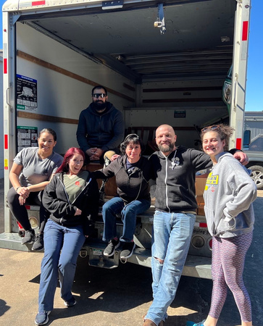

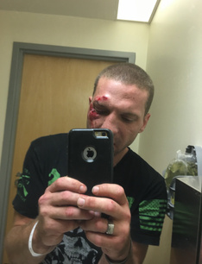

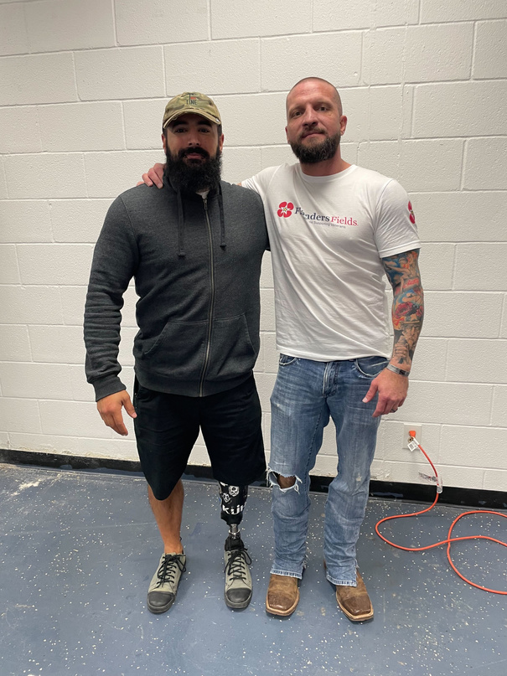

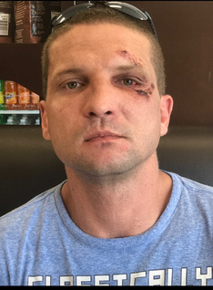

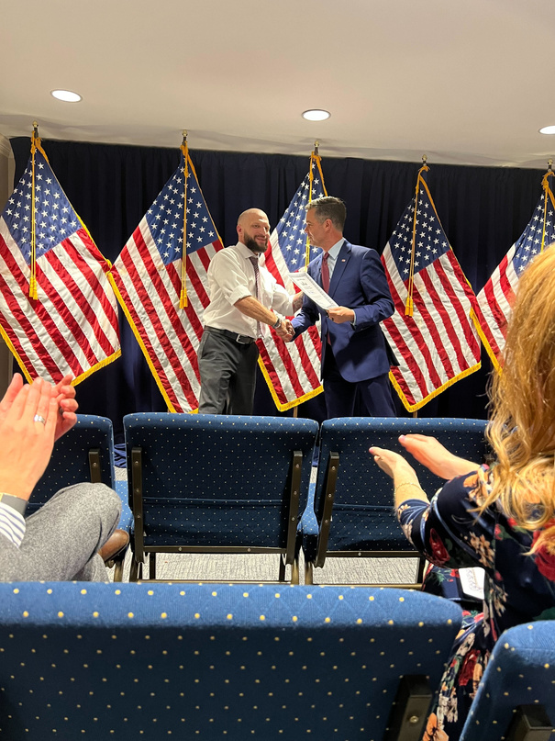
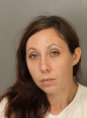
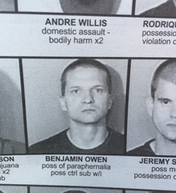

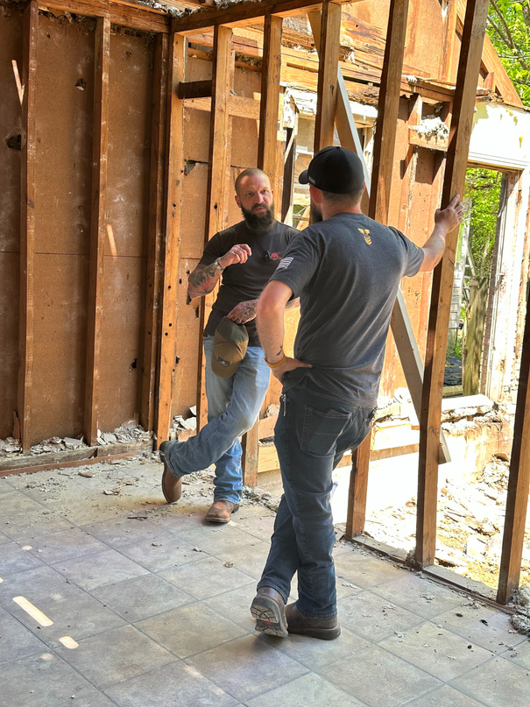


Ben & Jess Owen

Slide 2
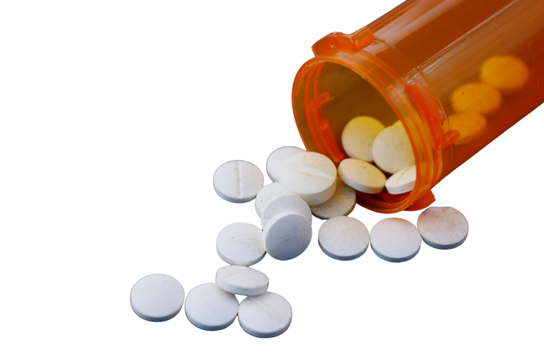
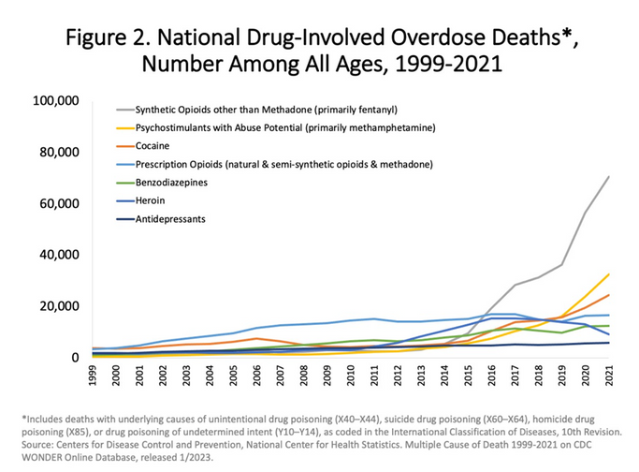
Fentanyl and Overdose
Synthetic opioids, (primarily fentanyl) have become the leading cause of drug-involved deaths among all ages

Slide 3
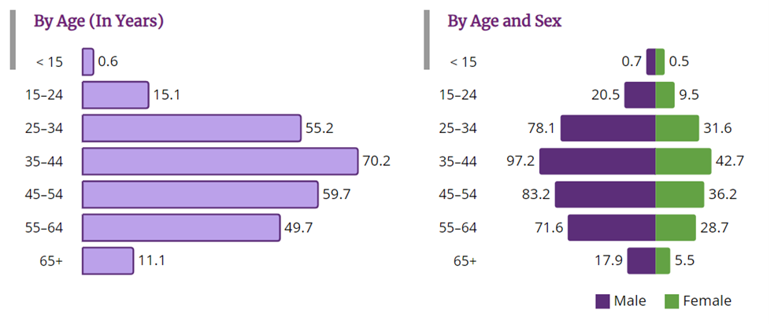

Fentanyl and Overdose
%of Total Overdoses by Age
(in years) (2022)
A study found that the presence/availability of naloxone in every state but Arizona is not even enough to reach 80% response rate to overdoses (based on 2017 data)

Slide 4
Fentanyl and Overdose
NONFATAL overdoses with testing (2022)
1,266
78%
FATAL overdoses (2022)
samples tested
positive for fentanyl (alone or with other substances)
51,435
60%
total overdose deaths
involved fentanyl (alone or with other substances)

Slide 5
Childhood trauma and drug abuse
of those who experience trauma by the age of 16 will begin to use alcohol or drugs
76%
80%
of 21 year olds who were abused have one or more psychological disorders
Children are 4x more likely to be neglected and 3x more likely to be abused, when parents abuse drugs or alcohol
4x
67%
67% of people in addiction treatment were neglected or abused as kids

Slide 6


Slide 7


Slide 8


Slide 9


Slide 10


Slide 11


Slide 12


Slide 13


